Slide 1

Hosting a Dynamic Website on AWS EC2
Welcome to this guide on deploying a dynamic website(CloudMed), specifically one providing medicine descriptions, using Amazon Web Services (AWS) EC2.

Slide 2
Software Walkthrough
Understanding Key AWS Services: EC2, S3, RDS, VPC, CloudWatch
Website Architecture Overview
Setting Up EC2 Instance
Database Configuration with RDS
Content Storage with S3
Networking with VPC
Monitoring with CloudWatch

Slide 3
Why AWS for Our Student Project?
Scalability
Cost-Effectiveness
Global Reach
Rich Feature Set
Easily adjust resources as our website grows, without upfront hardware investments.
Pay-as-you-go model and AWS Free Tier make it ideal for student projects.
Deploy our website closer to our users for better performance.
Access a vast array of services beyond basic hosting, enhancing functionality.

Slide 4





Core AWS Services for Hosting This Website
EC2 (Compute)
RDS (Database)
S3 (Storage)
Our virtual server for running the website's application code.(ubuntu)and connecting to the Database
Managed relational database service for storing user credentials. Data bases are used to store user details like email, password..
Scalable object storage for static files like images and CSS, JS, HTML and PDF files.
VPC (Networking)
CloudWatch (Monitoring)
Your isolated virtual network in the AWS cloud. For private and secure connection.
Observability for our resources and applications. To manage the server and increase Efficiency.

Slide 5

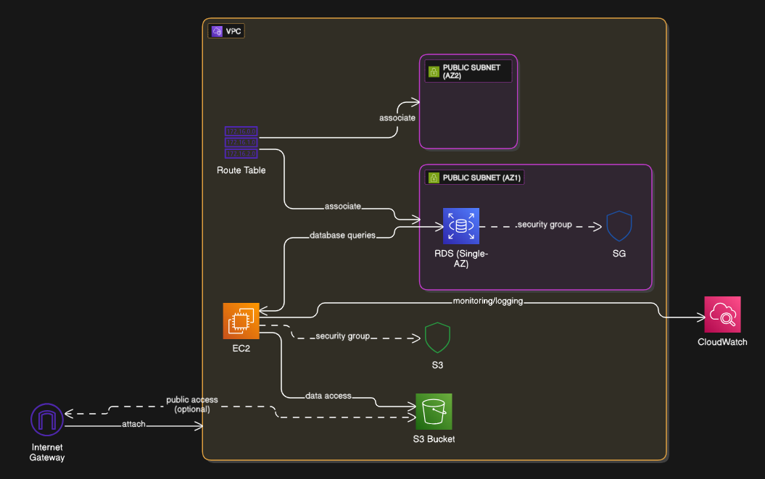
Website Architecture Overview
Our medicine description website will use EC2 as the web server, RDS for the database storing user data, and S3 for static assets. VPC provides a secure network, and CloudWatch monitors performance.

Slide 6


Setting Up Your EC2 Instance
1
2
Choose AMI
Instance Type
Select an Amazon Machine Image (e.g., Ubuntu) as our operating system template.
For a student project, a t3.micro (Free Tier eligible) is usually sufficient.
3
4
Key Pair
Security Group
Configure inbound rules to allow HTTP/HTTPS/SSH traffic (ports 80/443/22) and SQL/aroura (port 3306).
Used "Vockey" keypair provided by AWS..
5
6
Choosing VPC
Rather than choosing a default VPC , we can use custom VPC
Configure Storage
1x 8 GiB gp2 Root volume has been used for storage

Slide 7
Database Configuration with RDS
RDS simplifies database administration, allowing us to focus on developing our application rather than managing database infrastructure. Nodejs is used to connect ubuntu server and using RDS end point , username and password.
Engine Selection: Choose a database engine like MySQL suitable for User data.
Instance Size: Opt for a db.t2.micro (Free Tier eligible) for cost efficiency.
Security: Configure an RDS security group to only allow connections from our EC2 instance
Future Enhancement Path:• Multi-AZ deployment for production readiness

Slide 8
Content Storage with S3
Amazon S3 provides highly durable and scalable object storage. Use it for our website's static content, such as:
Images of medicines
Medicine Description PDF's
CSS stylesheets
JavaScript files
HTML files as Backup.

Slide 9
Networking and Monitoring
Virtual Private Cloud (VPC)
A logically isolated section of the AWS Cloud where we launch AWS resources. Define our own IP address range, create subnets, and configure route tables and network gateways. This ensures our medicine website has a secure and private network environment.
CloudWatch
Monitor our AWS resources and applications running on AWS in real-time. Collects and tracks metrics, collects and monitors log files, and sets alarms. This is crucial for observing the health and performance of our medicine website, identifying issues, and ensuring smooth operation.

Slide 10



Key Takeaways & Next Steps
Fundamental Understanding
Practical Application
Explore Further
We've learned how EC2, S3, RDS, VPC, and CloudWatch integrate to host a dynamic website.
Apply these concepts to build and deploy your own medicine description website.
Look into Amazon Rekognition, or CloudFront for content delivery.

